Slide 1

JEWEL THOMAS
BRANCH- AIML
TOPIC – ARTIFICIAL INTELLIGENCE IN HEALTHCARE

Slide 2

ARTIFICIAL INTELLIGENCE IN HEALTHCARE

Slide 3

Treatments are only based on current study
Hard to find a doctor who knows you.
Lack of knowledge
Unexpected deaths due to human errors

Slide 4


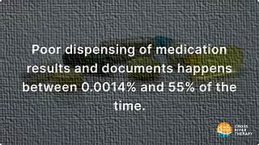
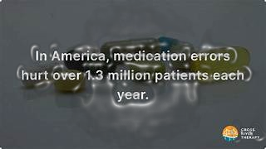
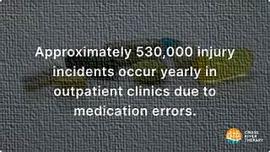

Slide 5
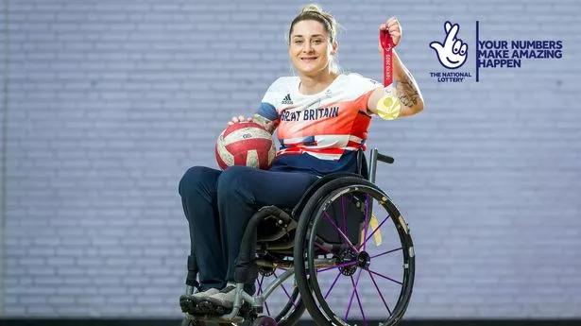
KYLIE GRIMES

Slide 6

AI IN DRUG DISCOVERY

Slide 7

AI IN DIAGNOSTICS

